Slide 1
DNA Computation Learning

Slide 2
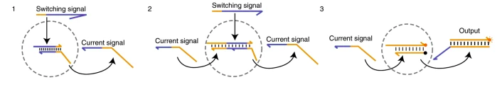
DNA Circuit: SDR based Boolean circuit
Mainly Three Steps:
Circuit respond to switching signal and generate a current signal.
Downstream switch respond to current signal. Produce current signal.
Finally a reporter respond to the current signal using fluorescent.
Rule: Downstream switch need current and switching signal.

Slide 3
One Switch Circuit vs two Switch Circuit
One Switch Circuit
Concentration: switch = 1x, switching signal = 2x
Step: mixed on buffer +Mgcl2, reaction at –20 degree.
Results:
Adding the switch signal result rapid response (t(1/2)=1min)
High output in 16 min
Two Switch Circuit
Concentration: upstream switch = 1.5x, downstream switch = 1x, switch signal = 2x to ensure activation.
Strategy: Upstream output is sufficient to activate downstream.
Results: Both signal present t(1/2)<3min. Faster than traditional DNA based logic gates.

Slide 4
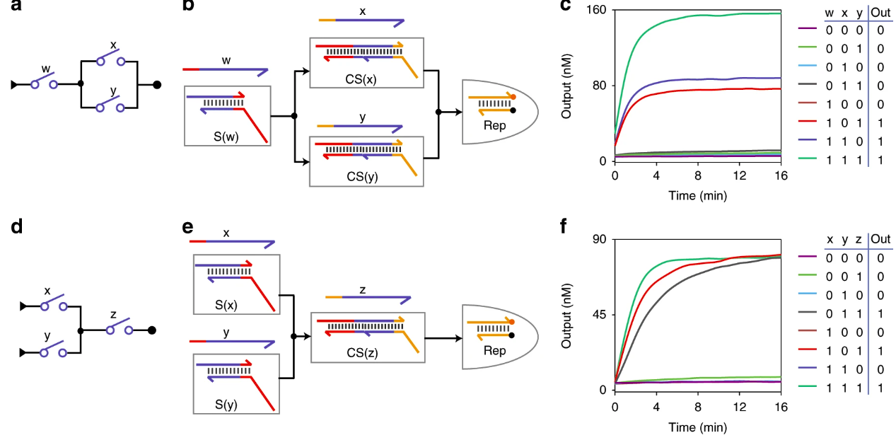
Fan-out vs Fan-in
Fan Out
Same current to multiple switches
Design: 3:1 ratio of upstream and downstream
Fan In
Multiple signal feed into one downstream
Design: Upstream signal have the same sequence

Slide 5
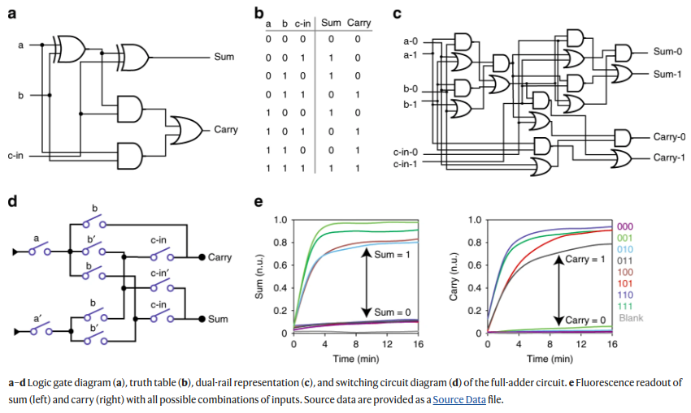
Full Adder with DSC

Slide 6
Discussion
Design Rules:
Upstream switch: Only an S domain.
Downstream switch: Both C domain and S domain.
Efficiency:
Handles NOT logic more efficiently.
Requires fewer computing elements, enabling more complex functions.
Applications:
High-speed, high-SNR molecular computing.
Potential in molecular computers, decision-making systems, and nanomachines.

Slide 7
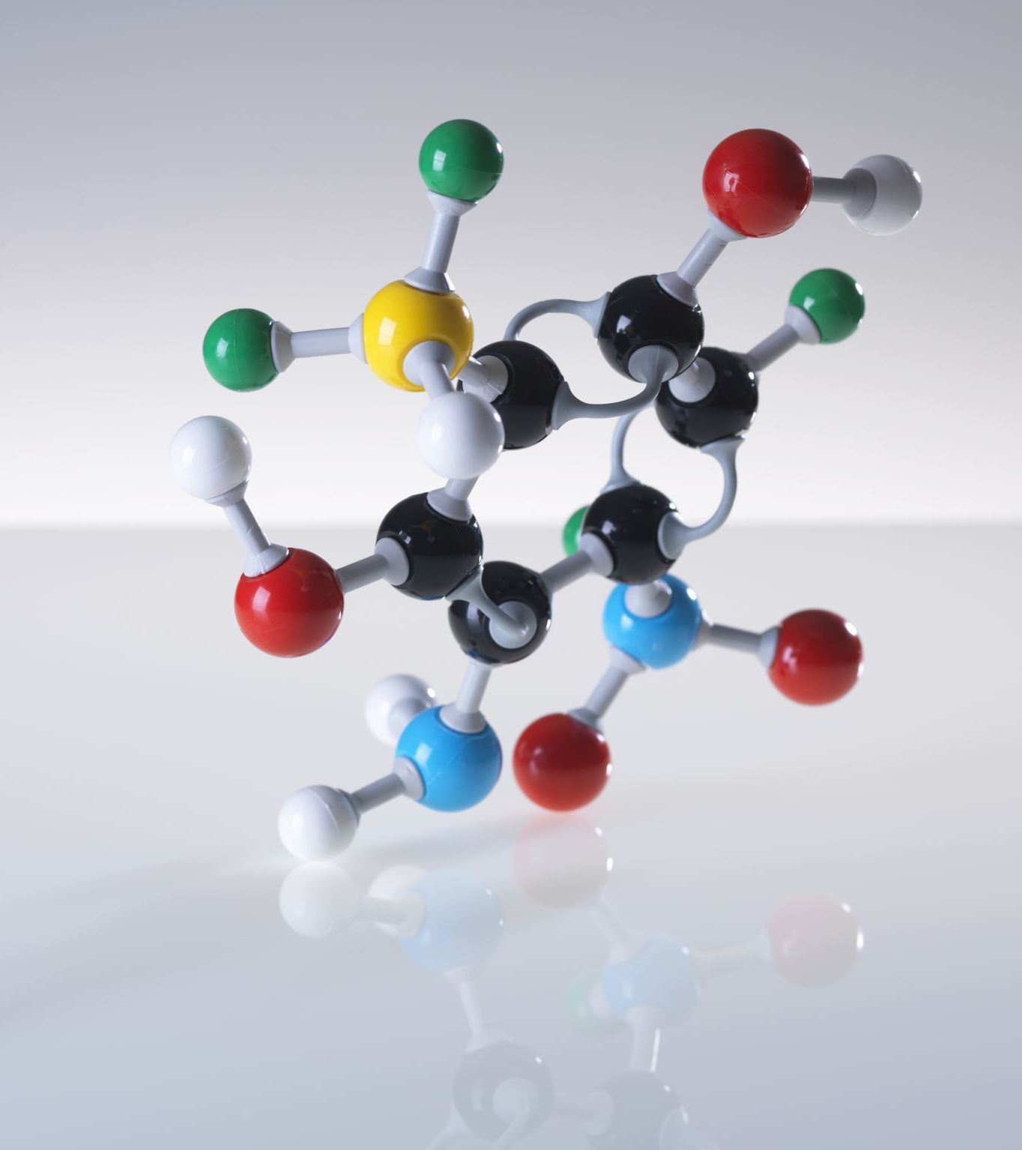
Molecular Computation for Molecular Classification
Disease pattern recognition and sample classification

Slide 8
Chapters
Section1: Introduction
Section2: Elementary Modules
Section3: Toolboxes
Section4: Create Classifier
Section5: Conclusion

Slide 9
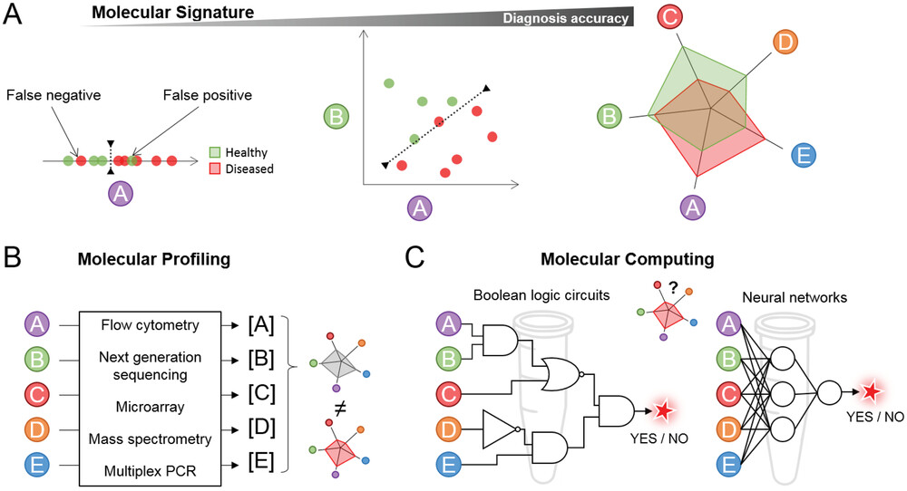
Introduction
Living organisms regulate diverse molecules for health and disease states.
Single-marker assays aid diagnostics but may lack robustness.
Multi-marker panels enable improved diagnosis and patient stratification (e.g., bacterial vs. viral infections, cancer detection).
Molecular classifiers emulate biological systems to recognize patterns at the molecular level.

Slide 10
Elementary Modules
Bio makers
Target Recognition and Signal Transduction
Signal Amplification
Thresholding
Readout

Slide 11
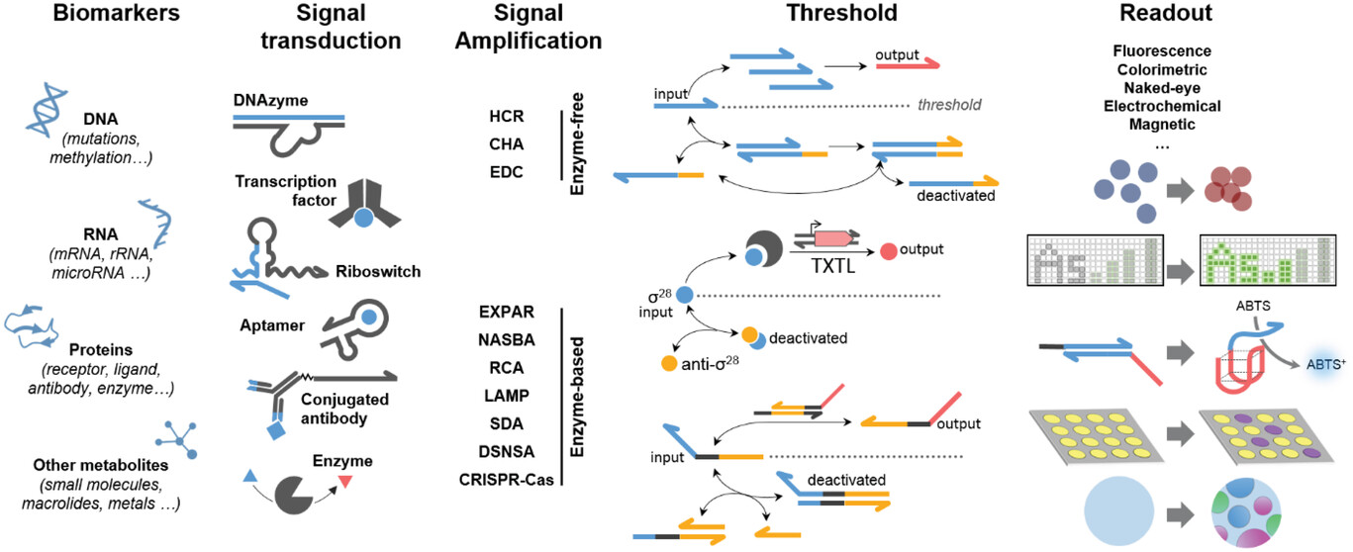
Elementary Modules

Slide 12
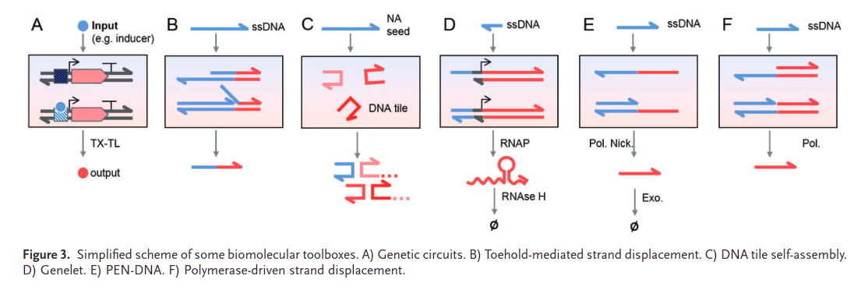
Toolboxes

Slide 13
Genetic Circuit
Cell uses several genetic circuit to sense inputs and produce tailored response.
Artificial genetic circuit can be built for computation.
Biosensors are versatile but faces challenges
Cell free biosensors can bypass issues but costly.
Cell and cell free support diverse transducer, amplification and output modules.

Slide 14
Enzyme free Systems
DNA hybridization is used for molecular computation via strand displacement.
Strand displacement can be irreversible (TMSD) or reversible (seesaw gates).
Functional nucleic acids like aptamers and ribozymes enable compatibility with various inputs.

Slide 15
DNA Tile Assembly
DNA tiles with sticky ends self-assemble into structures following logical rules.
Growth can be controlled by seed structures for sensitive diagnostics.
Can combine with strand displacement for spatiotemporal control.

Slide 16
Transcriptional Systems
Genelets rely on RNA polymerization and degradation, using RNA polymerases to produce RNA strands and RNAse enzymes to degrade them.
Alternatives: Hairpin-Based Circuits, RTRACS

Slide 17
DNA-Enzyme Systems
These systems leverage DNA templates and enzymatic processing to execute complex dynamic behaviors, such as oscillations, bistability, and excitable responses, with applications in diagnostics, biosensing, and synthetic biology.

Slide 18
Classifier

Slide 19
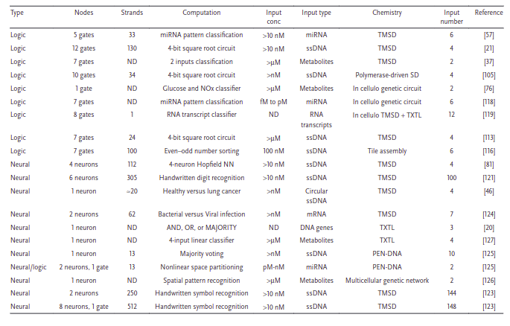
Boolean and Neural Network

Slide 20
Boolean and Neural Network
Boolean Logic Circuits
Inspired by electronic counterparts, with molecular gates outputting 0 or 1.
Advantages:
Robust to noise due to binary nature.
Limitations:
Do not account for the heterogeneity in biomarker concentration.
Handling continuous concentrations requires a large number of gates.
Neural Network Architectures
Operate by directly manipulating concentrations, enabling summation.
Advantages:
Compact design, requiring fewer nucleic acid strands.
Allows individual weight adjustments for flexibility.
Better suited for handling continuous concentration values compared to Boolean circuits.
Limitations:
Require signal amplification

Slide 21
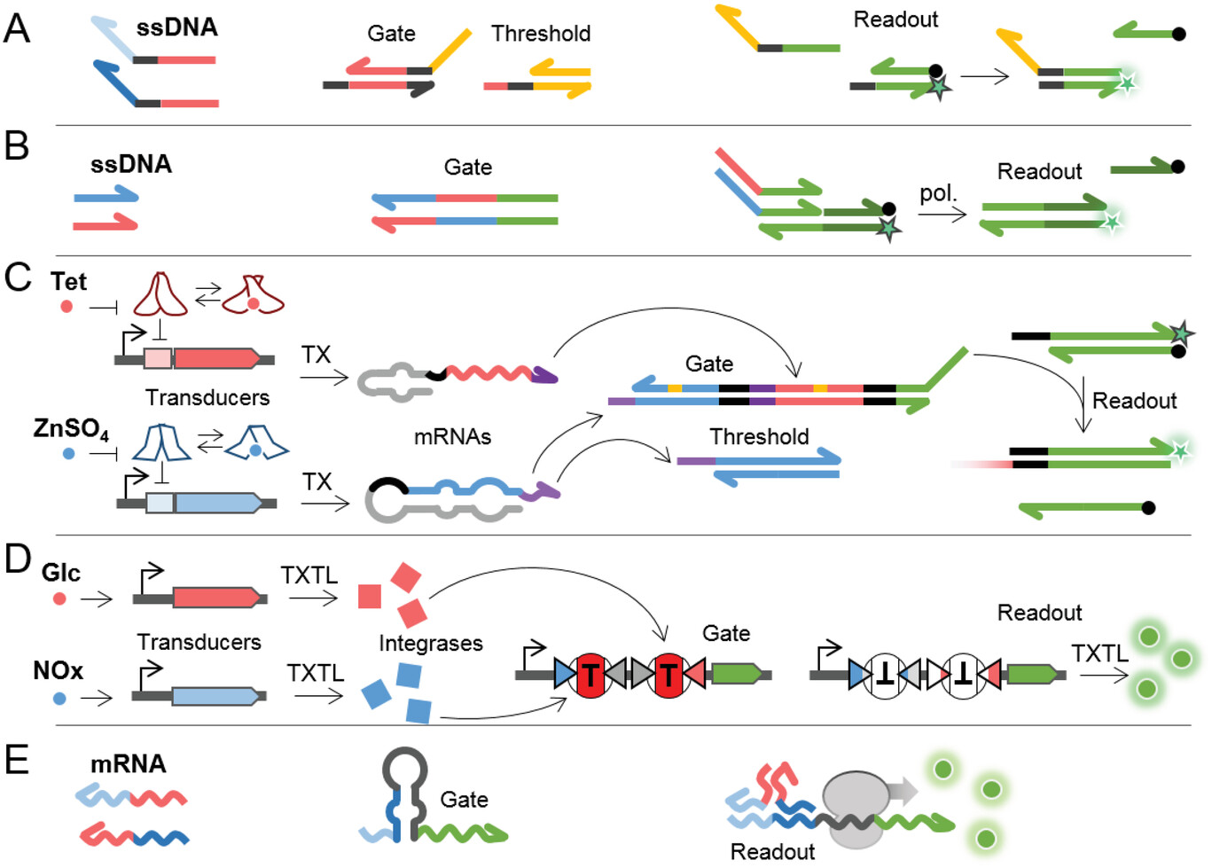
Boolean And Gate

Slide 22
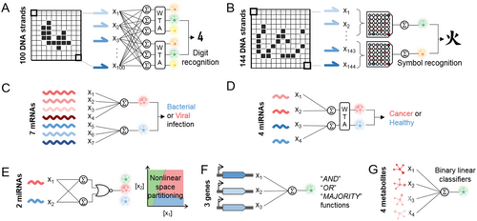
Neural Network

Slide 23
Conclusion
Biological Parallels in MNNs
MNNs have been applied to classify.
MNNs promise robust, low-cost diagnostics.
MNNs typically require high concentrations of input molecules.
Scaling molecular classifiers for broader clinical use requires addressing issues such as cross-reactivity etc.
MNNs lack in self-learning mechanisms like stochastic gradient descent.

Slide 24
Future Implications
Personalized Therapies
Dynamic and Implantable Devices
Low-Cost Global Health Solutions

Slide 25
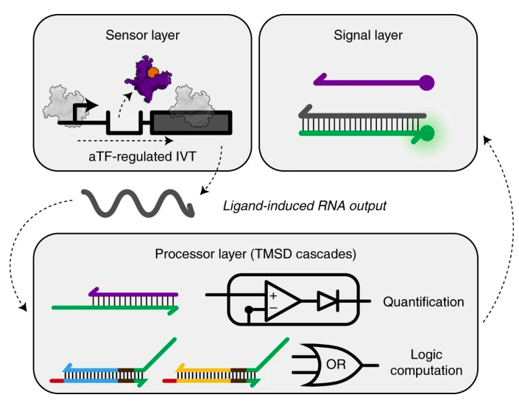
Application: Biosensors
Cell-free biosensors are low-cost, easy-to-use, and field-deployable diagnostic tools.
They are designed to detect a variety of chemical compounds relevant to human and environmental health.
Use SDR for processing the output.

Slide 26
Reference
https://www.nature.com/articles/s41467-019-13980-y
https://www.nature.com/articles/s41589-021-00962-9
https://onlinelibrary.wiley.com/doi/10.1002/adbi.202200203

Slide 27

Thank you

